Slide 1

Path to College:CS/CyberSec Extracurriculars
By: Dennis Freyman

Slide 2




Why Extracurriculars Matter for College Admissions
College Admissions
Demonstration of Passion
Leadership & Initiative
Colleges look beyond grades/test scores.
Show genuine interest in CS/cyber through sustained involvement.
Extracurriculars are the perfect platform to highlight these qualities.
Differentiation: Set yourself apart from other applicants with hands-on experiences and achievements.

Slide 3





Branches of Extracurriculars
School-Based Activities
Competitions & Challenges
Personal Projects & Research
Bug Bounty Hunting & Ethical Hacking
Volunteering, Teaching & Outreach

Slide 4
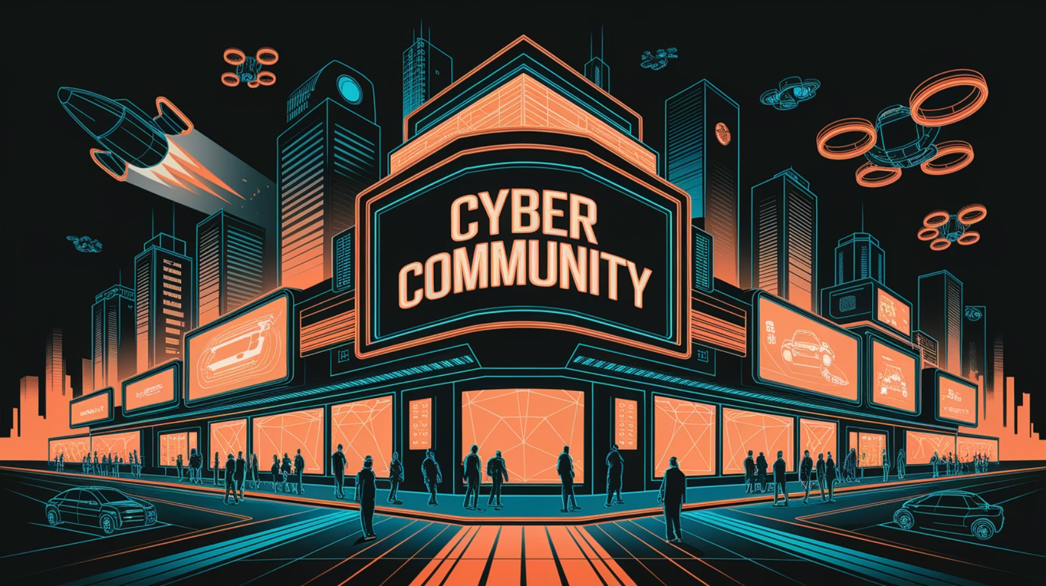

School-Based Activities
Have access to a community
Access to resources
Be in a community of other passionate students
Access to resources, mentors, etc

Slide 5


Cybersecurity Club
Participate in hands-on activities like CTF training, ethical hacking workshops, and security research.
Competition access
Many competitions cost money, and being in a club can give you acces to those things
Being in a club promotes learning, collaboration, and networking. This will benefit not only you, but others as well. Start by gathering interest and then finding a mentor. Finally, set goals and start creating things.

Slide 6

Team Environments
Knowledge Sharing
Continuous Learning
Team members bring diverse expertise, improving problem-solving.
Exposure to different attack vectors and defense strategies enhances skills.

Slide 7


Competitions in Computer Science
Programming Competitions:
Problem-Solving
Test your skills against other talented programmers.
Develop critical thinking and analytical abilities.
Coding competitions provide a fantastic way to hone your programming abilities. Compete with others, tackle challenging problems, and enhance your coding expertise. Success in these events showcases your talent and dedication.

Slide 8

Code-forces & LeetCode Contests:
1
Regular Competitive Programming Contests
Codeforces: Frequent contests
LeetCode: Weekly and biweekly contests with varying difficulty levels.
2
Real-Time Problem-Solving Experience
Simulates high-pressure coding environments.
Helps develop quick-thinking and debugging skills.
3
Competitive Edge for Technical Interviews
Many top companies use similar problem styles in coding interviews.
Builds confidence in handling time-restricted coding challenges

Slide 9

USACO: The Premier Programming Competition
1
What is USACO?
The USA Computing Olympiad is a national-level competition for pre-college students.
2
Skills Tested
Algorithms, data structures, and problem-solving abilities are key.
3
Benefits
Top performers gain recognition and potential college scholarships.
USACO is a prestigious competition that challenges students in algorithms and data structures. Participating and excelling in USACO demonstrates a high level of programming proficiency and can open doors to opportunities.

Slide 10

Cybersecurity Challenges & CTFs
Capture The Flag (CTF) Competitions:
Skills Gained:
Tip: Form or join a team to share knowledge and collaborate.
Learn ethical hacking techniques, cryptography basics, forensics, and more.
picoCTF, National Cyber League, HackTheBox, Dreamhack, etc
Showcase ability to think critically and protect systems.

Slide 11

CyberPatriot: Defending Networks, Learning Security
What is CyberPatriot?
1
A national youth cyber defense competition.
2
Skills Learned
System administration, network security, and forensics.
Benefits
3
Teamwork, leadership, and career opportunities.
CyberPatriot is a leading cyber defense competition where teams manage and secure virtual networks. Participants gain valuable skills in system administration, network security, and forensics. It promotes teamwork, leadership, and opens doors to career paths.

Slide 12



Certifications & Online Courses
Online Learning Platforms:
Certifications to Consider:
2
Coursera, edX, Udemy, Khan Academy
GIAC Certs
CompTIA (ITF+, A+, Network+, Security+)
1
Cisco (CCNA)
Value to Your Profile:
(ISC)² Certified in Cybersecurity (entry-level).
Demonstrates depth of knowledge and professional readiness.
3

Slide 13




Personal Projects & Open-Source Contributions
1
Deep Learning
2
Skill Building
3
Innovation
4
Exploration
Possible Project Ideas:
Develop a small web app or mobile app.
Work on cybersecurity tools or scripts (e.g., using Python).
Contribute to GitHub open-source projects to learn collaboration and version control.
Congressional App Challenge
Microsoft Imagine cup

Slide 14
Volunteering & Teaching Tech
Tutoring/Workshops
1
Teach basic programming or cybersecurity to younger students.
Community Outreach
2
Help secure small businesses' networks or assist with tech literacy programs.
Non-Profit Involvement:
3
Contribute to STEM outreach programs, local coding bootcamps, or mentorship initiatives.
Public Speaking & Awareness
4
Present cybersecurity topics at school events, local meetups, or online webinars.
How This Helps You:
Reinforces your knowledge, develops public speaking skills, demonstrates civic engagement.

Slide 15
Bug Bounty Hunting & Ethical Hacking:
Bug Bounty Programs: Report security flaws on HackerOne, Bugcrowd, Intigriti, and Synack.
Web & Network Security: Learn OWASP Top 10 vulnerabilities and practice on TryHackMe or Hack The Box.
Hall of Fame Recognition: Earn acknowledgments from major companies (Google, Apple, Tesla).
Earn Money & Gain Experience: Some top bug bounty hunters make thousands per vulnerability report.

Slide 16


